Slide 1
Lecture 7
Advanced Algorithm Analysis

Slide 2
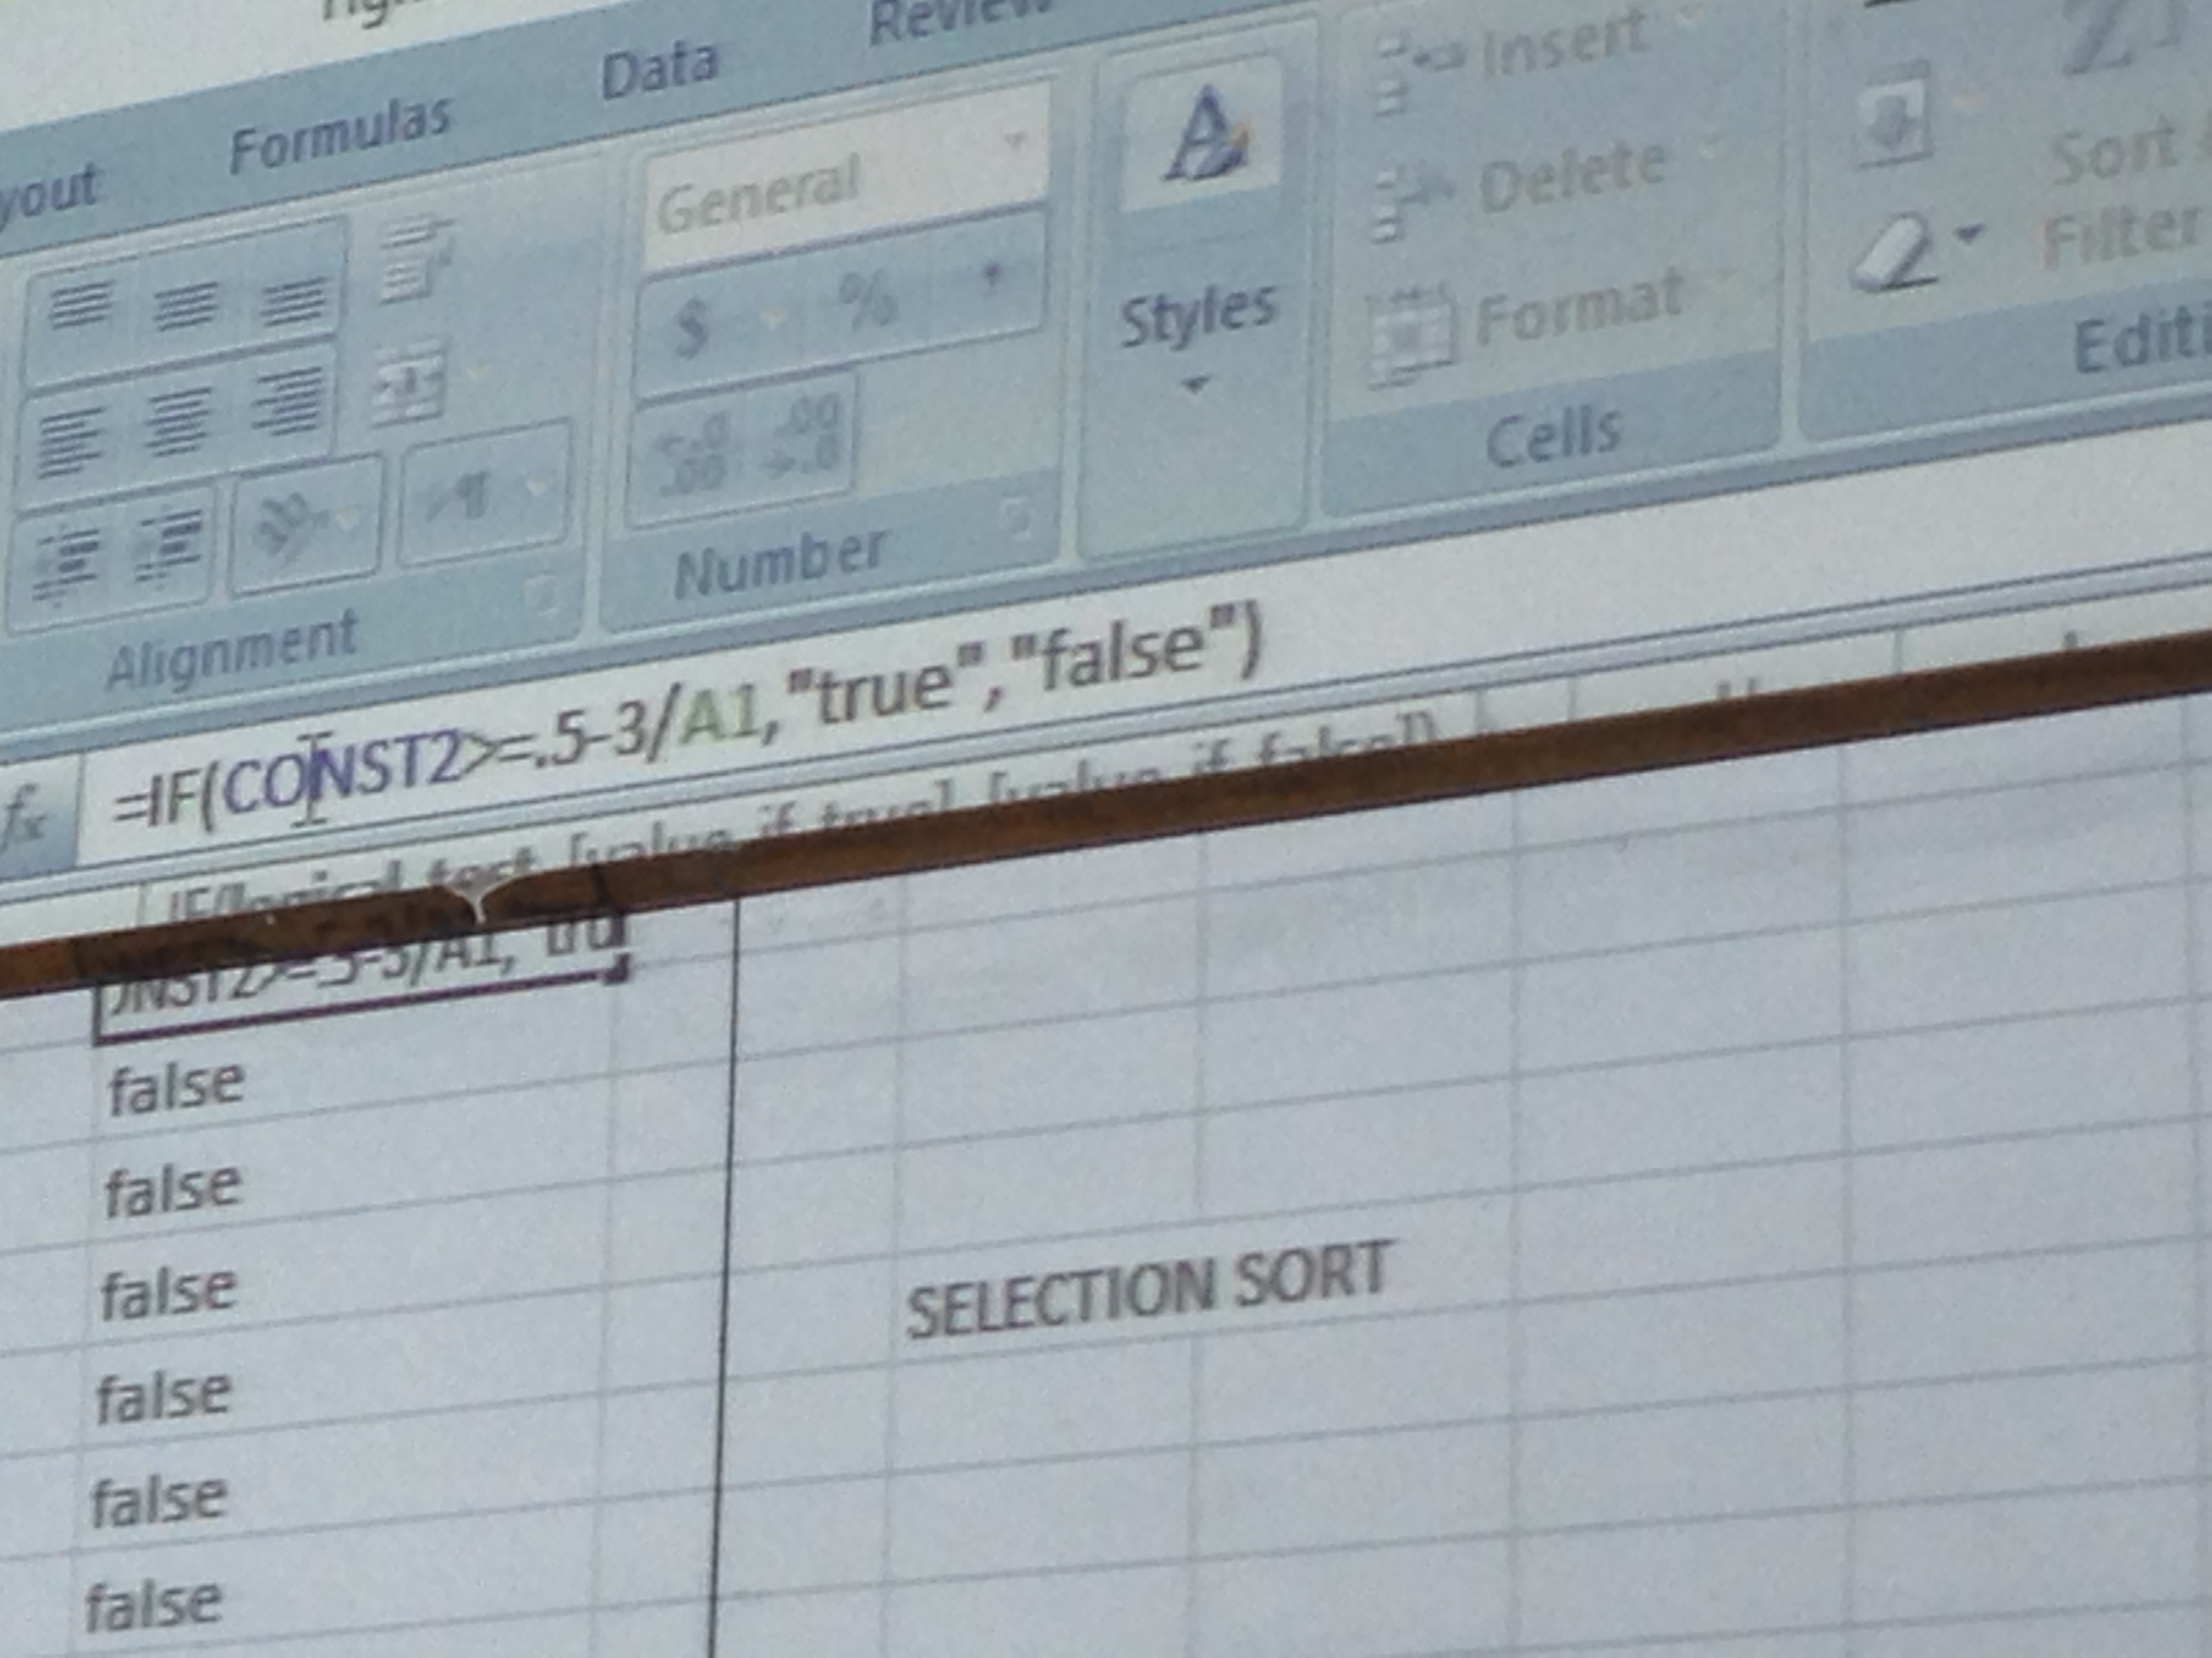
Excel Formula For Automatic Asymptotic Analysis

Slide 3
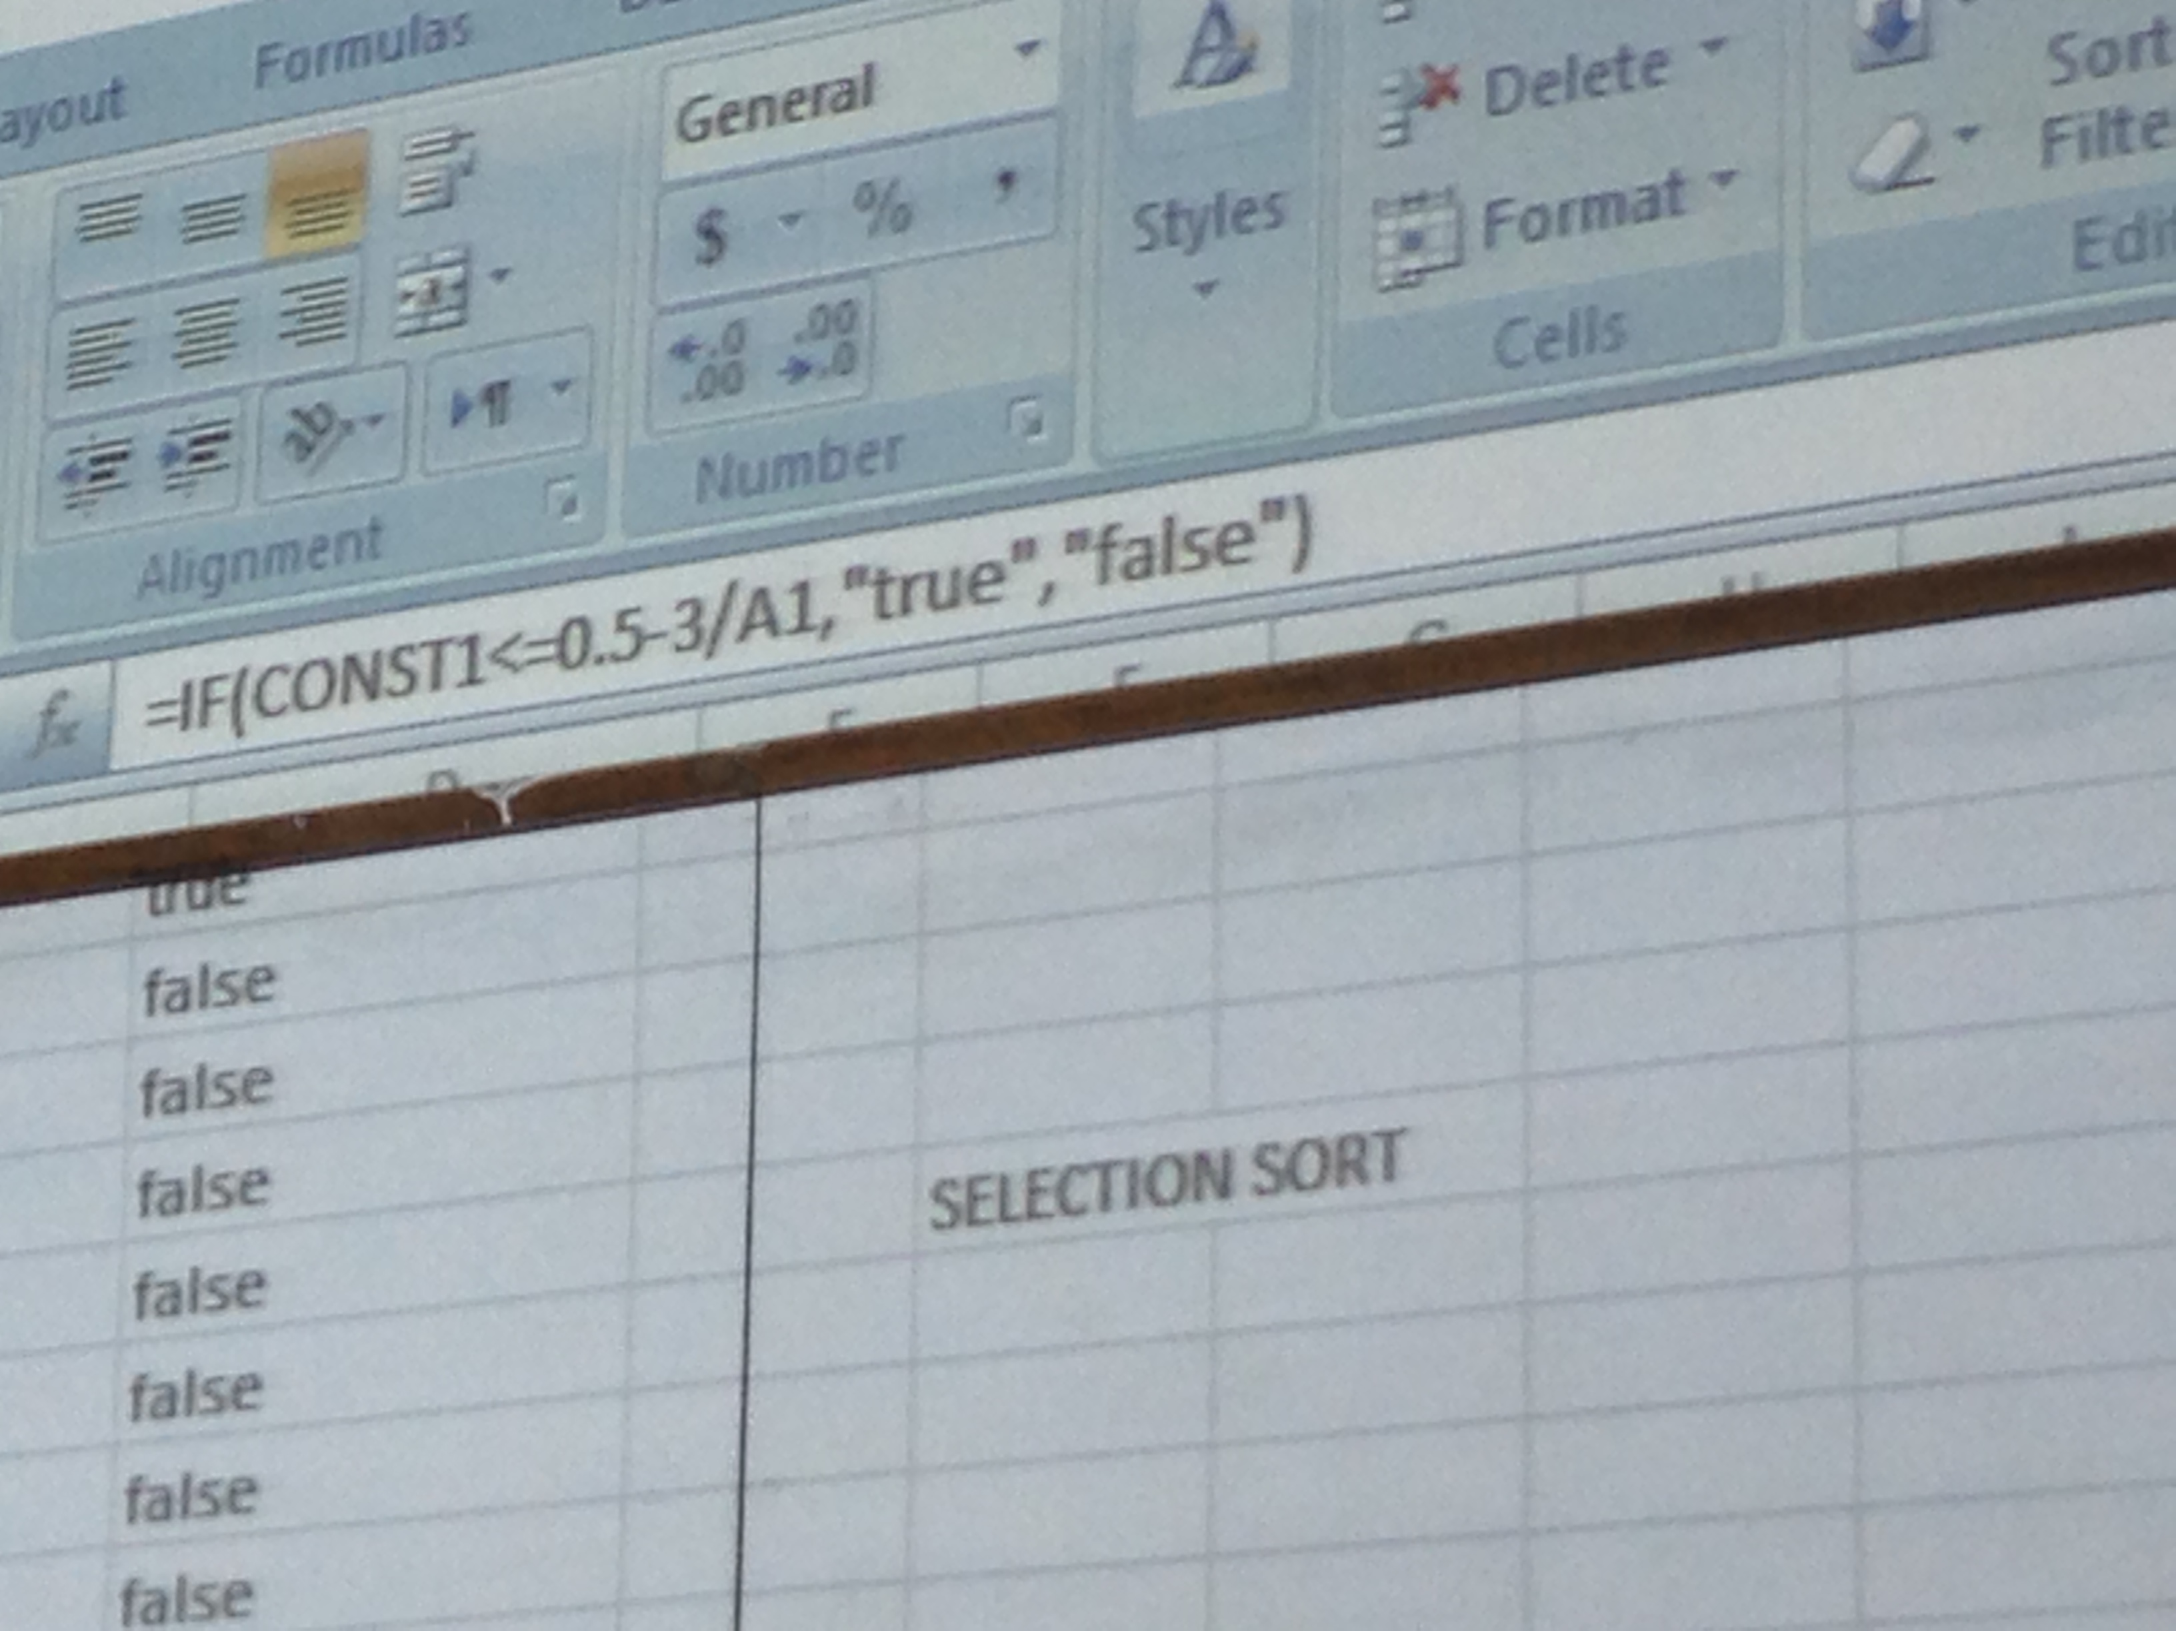
Excel Formula For Automatic Asymptotic Analysis

Slide 4
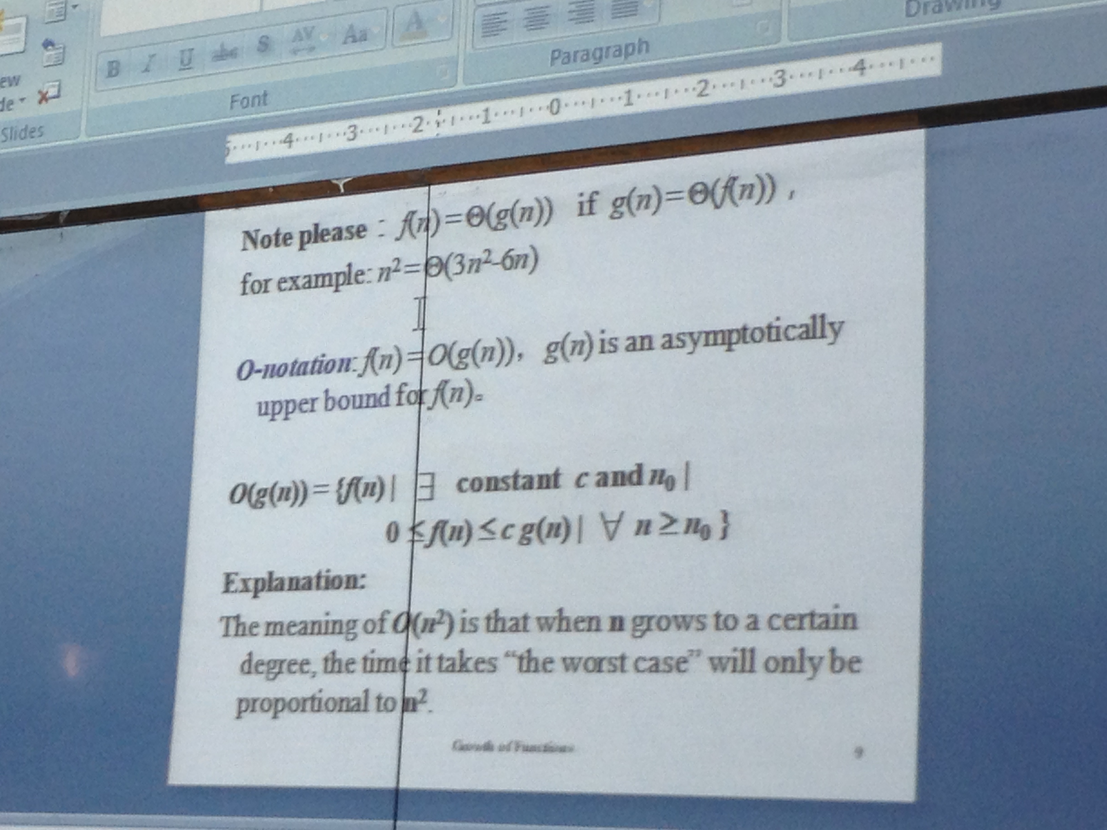
Constraints for Big O Notation

Slide 5
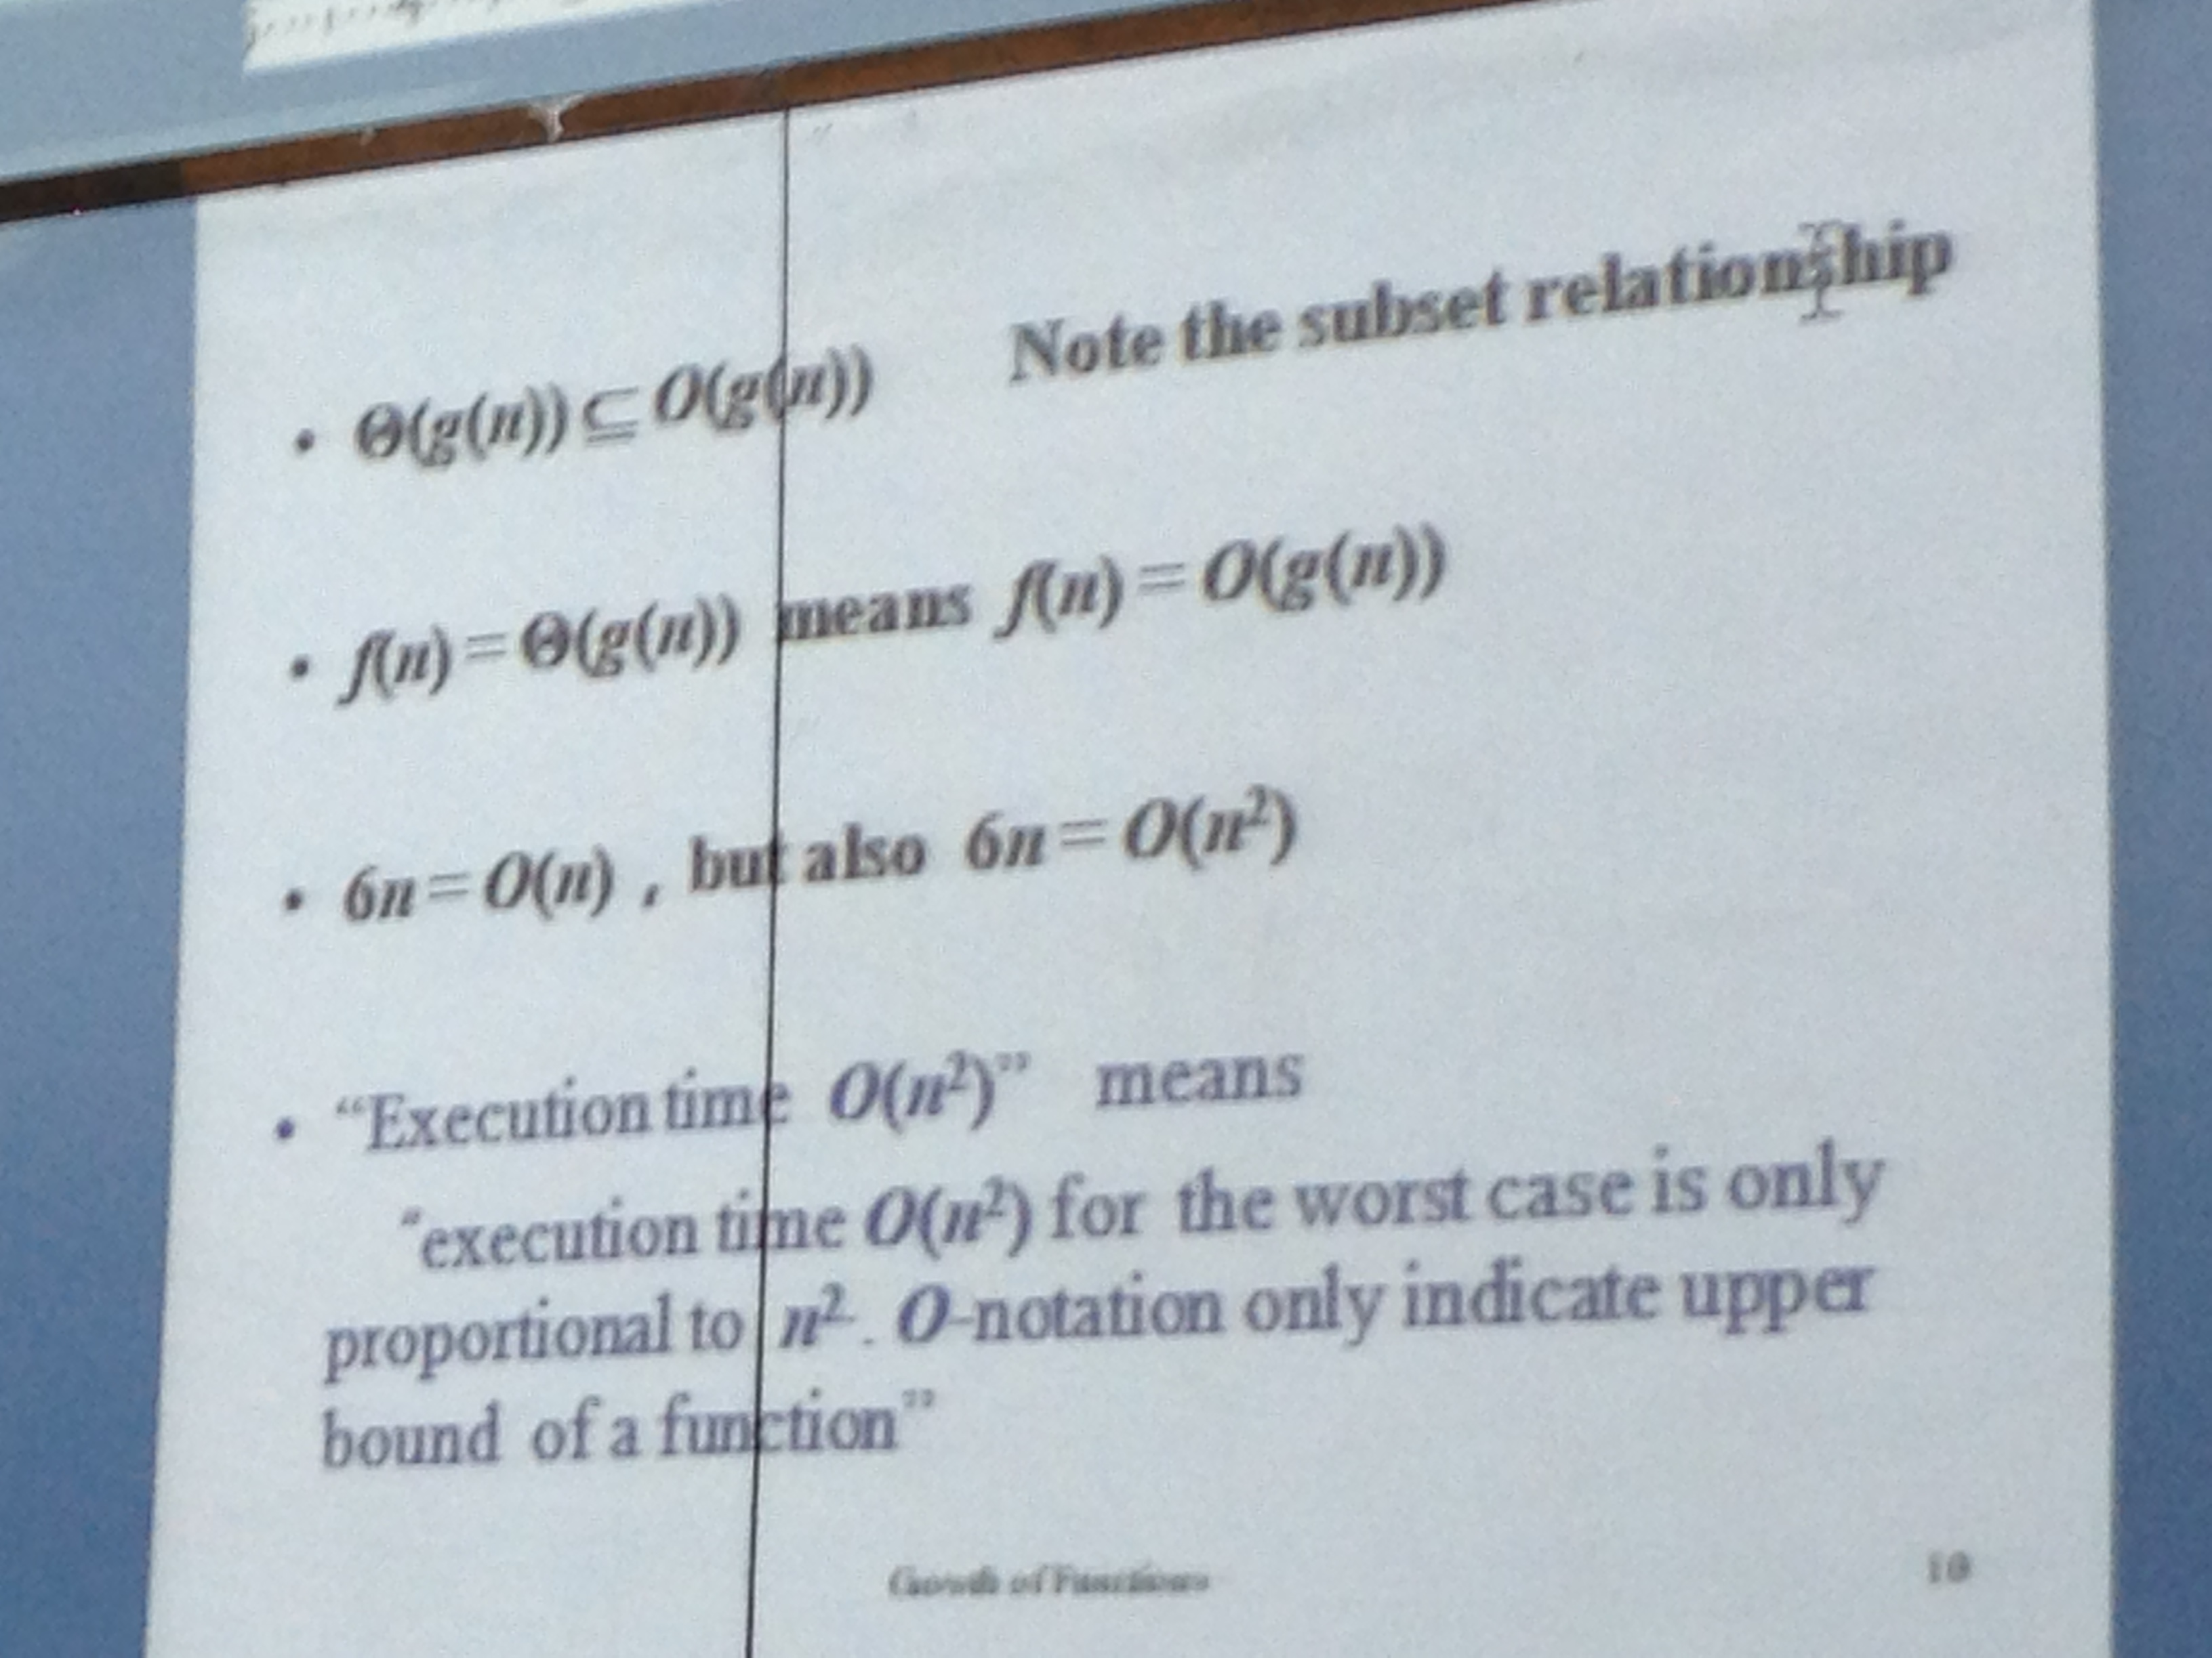
Big O Notation

Slide 6
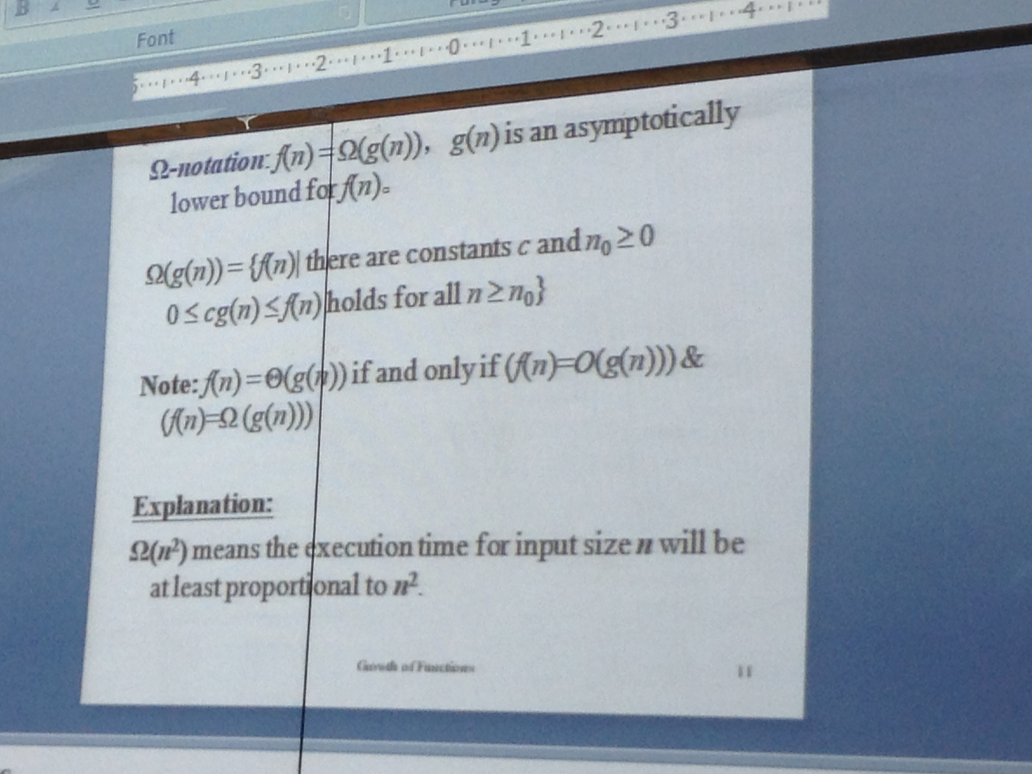
Constraints for Big Omega Notation

